Slide 1

We will be with you shortly.

Slide 2
Homepage - Surrey Safeguarding Children Partnership (surreyscp.org.uk)
SSCP-Final-Neglect-Strategy-2021-2023-1.pdf (surreyscp.org.uk)
Neglect-Strategy-on-a-page-April-2021.pdf (surreyscp.org.uk)
Family Resilience and Early Help - Surrey County Council (surreycc.gov.uk)
If you’re concerned about a child call 0300 470 9100 or email cspa@surreycc.gov.uk

Slide 3
Detective Chief Superintendent Sailesh Limbachia
Head of Public Protection

Slide 4

GCP2
Lunchtime
Work shop
Co-existence of Domestic Abuse and child neglect

Slide 5
Aims of the session
To explore the context of child neglect when Domestic Abuse is a factor
To consider the impact of Domestic Abuse on parenting capacity to avoid victim blame
To encourage reflective thinking around professional curiosity and being more trauma informed

Slide 6
Context of DA in a case study of child neglect
Situation

Slide 7
Concerns identified in referrals
Referrals made to ESDAS Children’s Service and CAMHS to work with mum’s children

Slide 8
Services Responses
CAMHS – suggested other therapeutic intervention explored first to address the trauma
SCHOOL - School Nurse supporting child’s ‘medical’ needs and a Teaching Assistant supporting in class. Two siblings are in the same class due to birth dates. Oldest child is protective of his sibling and is described as the ‘perfect child’
CHILDREN’S CENTRE – Leading the TAF and offering family support
ESDAS – Adult Outreach offered to mum and 1:1 sessions offered to eldest child in school as mum felt he was ‘more affected’
CHILDREN’S SERVICES – ESDAS made referral to C-SPA, which was declined as appropriate professionals already involved in the TAF
Further referral made to C-SPA with on-going neglect concerns following mum’s disengagement with all professionals and consequential closure of TAF
MAP enquiry identified level 4 criteria, however, this was subsequently stepped down to Early Help following a phone conversation with mum and then closed

Slide 9
Narratives Embedded into a Belief System
I am a rubbish parent
A person has two choices - to be the aggressor or be the victim
I won’t be believed
Women are weak, helpless, incompetent, stupid, or violent
My children will be taken away
I have mental health issues and can’t cope
I’m unlovable
Unhealthy, unequal relationships are normal or to be expected
Men are in charge and get to control women's lives
Women don't have the right to be treated with respect

Slide 10
Parenting Capacity & DA
basic care – links between CCB and Neglect
ensuring safety- distorted views of ‘managing the situation’
emotional warmth- numbing. Demands from perpetrators for mother’s attention can be at the expense of the child
Stimulation- limited opportunities due to CCB
guidance and boundaries- often sabotaged
Stability- CCB creates inconsistency and unpredictability
Notes:
DA Bill webinar information
Parenting Capacity: "the ability to parent in a 'good enough' manner long term" (Conley, 2003) – Not a high threshold.
Risky Parenting: neglecting basic needs; putting adults' needs first • chaos and lack of routine • and an unwillingness to engage with support services (Kellett and Apps, 2009). These are all caused by CCB.
Basic Care: Links between CCB & neglect. Leah used to want me to sit and brush her hair – that wasn't allowed because he'd be jealous. He'd say: “You've spent enough attention on her, what about my attention?”’
Ensuring Safety: Methods of ‘managing the situation’ may become flawed due to distorted perspectives.
Emotional warmth: Carers affected by domestic abuse usually exhibit a lack of emotional warmth and higher levels of aggression and rejection (Calder et al, 2004). Even if they try to create a nurturing environment, these attempts can be undermined by the child sensing the fear and anxiety of the person being abused (Buchanan et al,) ‘perpetrators/fathers demanded high levels of attention from mothers at the expense of children ‘Lots of times when Mum was giving me attention he'd tell her to go over to him so she'd have to leave me to play by myself.’ ( Shannon, aged 10)
Stimulation: ‘Well some days he [perpetrator/father] would be out, and me and Mum would watch a movie and have some time together, which he wouldn't let us do when he was there.’ ( Katie, aged 12)
Guidance & Boundaries: parenting sabotaged by perpetrators. Survivors too exhausted from ‘managing the situation’
Stability: CCB creates a It creates an inconsistent and unpredictable environment for children.

Slide 11
Impact of CCB on children
Control of time, movement and activities within the home
Constraint of use of space/self-expression
Regulation of speech and behaviour
Narrowed space for action
Isolation from sources of support
Vigilant scanning & monitoring of space
Concept of safe and risky spaces/areas in the home and/or times of the day
Miniature radar devices – striving to predict the unpredictable
Notes:
LINK TO JACK’S CASE STUDY
Control of Time, Movement and Activities within the Home
A key non‐violent aspect of perpetrators'/fathers' domestic violence that impacted on children was their control over how mothers spent their time within the home. Mothers and children described how perpetrators/fathers demanded high levels of attention from mothers at the expense of children:
‘’
Narrowed Space for Action
Lauren's daughter Zoe's exposure to physical violence against her mother was minimal. However, Lauren reported that Zoe, aged 3 experienced delayed speech and had not begun to speak regularly until she and her mother had been living apart from the perpetrator/father for many months. It may be that living in an environment where the perpetrator/father often demanded that Zoe be quiet contributed to Zoe constraining her own voice as a survival strategy.
Isolation from Sources of Support
Several perpetrators/fathers also controlled mothers' movements outside the home. Data from mothers highlighted how this controlling tactic not only affected them; it also severely restricted children's social lives by preventing them from engaging with wider family, peers and extra‐curricular activities:
‘Kids' parties were another problem because he'd be accusing me of trying to “get off” [have sexual relations] with one of the dads, so parties were out the question. We couldn't do any after‐school clubs because I had to be back by a certain time. Me and the kids weren't allowed to go round to see his [perpetrator's/father's] mum.’ ( Isobel, mother)
“coercive control often prevented children from spending time with their mothers and grandparents, visiting other children's houses and engaging in extra‐curricular activities. These non‐violent behaviours from perpetrators/fathers placed children in isolated, disempowering and constrained worlds which could hamper children's resilience and development and contribute to emotional/behavioural problems” Katz (2015)
Highlight that SafeLives Spotlight on parenting and domestic abuse includes a podcast interview with Emma Katz and other podcasts, blogs and Webinars on survivors experiences of children’s services.
http://www.safelives.org.uk/spotlights/spotlight-8-parenting-through-domestic-abuse

Slide 12
The Roles of the Child Survivor
The Caretaker
Mother’s Confidant
Abuser’s Confidant
Abuser’s Assistant
Perfect Child
Referee
Scapegoat

Slide 13
Be Trauma Informed
Uninformed
They have ADHD
They have an anger management problem
They are disruptive
They have poor coping skills
Don’t talk about it
They are permanently damaged
They need consequences
Trauma informed
They are reacting to trauma
They have difficulty regulating emotions
They have been triggered
They have survival skills
Talking gives permission to heal
They can learn, heal and recover
They need support, routine and self-worth

Slide 14
Missed Opportunities and use of professional curiosity
Learning from DHRs and SCRs
Overlooking Vulnerability – not recognising the impact of trauma. Risk of minimising and denying DA
Poor Communication – not consulting with other professionals for known information
Not Referring to MARAC
Not identifying children at risk – missing the co-existence of DA and neglect and children as direct victims
Collusion and abuse of process – can cloud judgements of risk level
Parental alienation – mis-understanding of fear, shame and low confidence leading to victim blame
Notes:
Overlooking Vulnerability: This included instances related to not recognising times when vulnerability is heightened (e.g. following a separation or during pregnancy) and others were around social services focusing on the protection of children but overlooking the vulnerability of a mother.
Poor Communication: In ten DHRs, information was not shared, or communication was poor. This included examples of agencies not passing information to Children Services as well as CS not communication appropriately with parents – Surrey examples.
Not referring to MARAC: In eight DHRs, there were issues with multi agency working including like the Police or Children Services not referring to / participating in the local MARAC.
Not identifying children at risk: In six DHRs, agencies did not identify children at risk, either as the children of a victim, or as victims themselves
Collusion & abuse of process: In a DHR in Lambeth, the victim (Sophia) was contacted by Children’s Services as a result of an allegation by her ex-partner. The complaint itself was likely an example of ‘abuse of process’. That wasn’t recognised, in part because Children’s Services took an incident-based approach. But it was also clear that Children’s Services didn’t draw on the information known to other agencies – including the police, a domestic abuse service and schools. That was significant because those other agencies had part of the bigger picture of Sophia’s experiences, as well as the behaviour of the perpetrator. The result was that the case was assessed as low risk and closed
Parental alienation: Mothers accused or parental alienation wrongly – Sarah Healey. Perpetrators successfully alienation – Local case of Doris.

Slide 15
OFSTED REPORT
Domestic abuse as ‘the most common factor in the lives of children who need social care services,’
What is needed is a greater ‘emphasis on tackling perpetrators and understanding what works to stop abusive behaviour.’
There is a skills and empathy gap, which means many frontline professionals place blame on the victim, lack understanding of the dynamics of abuse, become frustrated at the lack of meaningful engagement with the victim, or are manipulated by tactics employed by perpetrators.

Slide 16
Ofsted Update March 2021
What needs to improve…..The analysis of risk and planning for children experiencing long-term neglect
For some children, over-optimism by professionals regarding parental capacity to change or sustain improvements has resulted in multiple interventions, and they have continued to live in circumstances of neglect for too long

Slide 17
How does the DA Act deal with children affected by domestic abuse?
It recognises the devastating impact that domestic abuse can have on children exposed to it in their own home.
Part 1 of the Act provides that a child who sees or hears, or experiences the effects of, domestic abuse and is related to the person being abused or the perpetrator is also to be regarded as a victim of domestic abuse. This will help to ensure that locally commissioned services consider and address the needs of children affected by domestic abuse.
A key function for the DA Commissioner is to encourage good practice in the identification of children affected by domestic abuse and the provision of protection and support for these children.

Slide 18
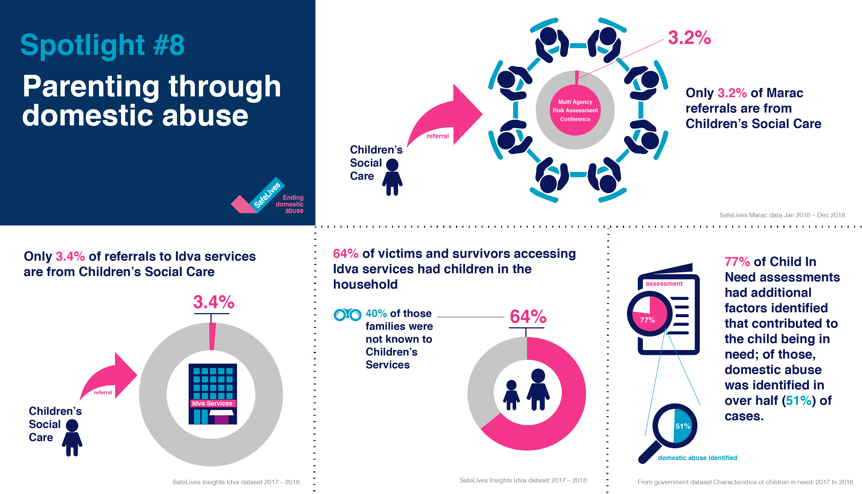

Slide 19
In Plain Sight: the evidence from children exposed to domestic abuse (Feb 2014)
‘An estimated 130,000 children in the UK live in households with high-risk domestic abuse; that is, where there is a significant risk of harm or death. And those are only the tip of the iceberg: many thousands more live daily with lower level domestic abuse. A strong relationship has already been shown between the maltreatment of children in the home and domestic abuse of a parent. For instance, Brandon et al. (2011) showed domestic abuse to be a factor in two thirds of Serious Case Reviews where a child has died.’

Slide 20
Multi-Agency Domestic Abuse Training Framework
3
months
Introduction to Domestic Abuse Awareness
E-Learning
‘Domestic Abuse: Understanding Coercive Control & the Multi-Agency Framework’
2 day course
6 months
Domestic Abuse: Train the Trainers
3 day course
DA: The Impact on Children & Parenting Capacity
1 day course
DA: The Legal Framework
1 day course
DA: Dynamics within the LGBT+ Population
½ day course
DA: Safely Engaging with Perpetrators
1 day course
20
20
20
20
Notes:
20

Slide 21
When there is a safeguarding concern, make a referral
For safeguarding concerns related to children-
Children’s Single Point of Access (C-SPA): 0300 470 9100 (option 1)
Emergency Duty Team (outside normal working hrs): 01483 517898
For safeguarding concerns related to adults-
Multi-Agency Safeguarding Hub (MASH): 0300 470 9100 (option 2)
Emergency Duty Team (outside normal working hrs): 01483 517898
Schools and Early Years Child Protection Consultation Line: 0300 470 9100 (option 3)
Surrey domestic abuse helpline: 01483 776822
9am to 9pm, 7 days a week provided by yourSanctuary

Slide 22

We must understand before we judge

Slide 23
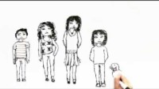

Slide 24

GCP2 Project Manager Alex Dave
Graded-Care-Profile2-FAQs.pdf (surreyscp.org.uk)
Neglect Risk Assessment Tools – General Guidance
Graded Care Profile 2: measuring care, helping families - YouTube

Slide 25

GCP2 Project Manager Alex Dave

Slide 26
Simon Hart
SSCP Independent Chair

Slide 27

Family Information and Local Offer
Children who make good overall progress in most areas of development and receive appropriate universal services such as health care and education.
They also use leisure and play facilities, housing and the voluntary sector.
Family Information Service (information on resources) www.surreycc.gov.uk/people-and-community/family-information-service/

Slide 28
The SCSA partnership learning and development offer aims to enhance working together to safeguard children and improve outcomes for children and families in Surrey. Our workshops and learning events give the opportunity for practitioners to:
Share knowledge and explore understanding of their differing roles
Understand how safeguarding operates in Surrey by sharing good practice, resources and processes; this includes Effective Family Resilience and Family Safeguarding model
Learn from each other’s experience and practice in terms of safeguarding and delivering positive outcomes for children
Develop best practice and learning from local reviews and audits, domestic homicide reviews, the Child Death Overview Panel (CDOP) and national learning

Slide 29
Core Offer
Learn together to ensure clear pathways for support, effective multi-agency working and early help provision as well as clear understanding and consistent application of thresholds across the partnership
Working together to safeguard children (online offer, face to face and Train the Trainer)
Effective Family Resilience
Helping Families Early
Foundation Modules 1 and 2
DSL new to role and refresher (Education Safeguarding Team)
Managing Allegations against staff and volunteers (Education Safeguarding Team) – includes sessions for non-education practitioners
Healthy outcomes for children who are looked after

Slide 30
Olive booking link; https://surreycoun.plateau.com/learning/user/portal.do?siteID=SCA&landingPage=login
Neglect training offers to ensure that practitioners are supported with the awareness, skills and tools to effectively intervene where neglect is a factor;
Introduction to Neglect
GCP2 programme (includes Train the Trainer)
Train the Trainer (Learning from Practice)
Included in all learning activities of the core offer
Introduction to Neglect Workshops
19 July 2021
06 October 2021
02 February 2022
27 April 2022

